Slide 1
Data Science Job Postings Skill Analysis
Anusmriti Sikdar
Yasaman Emami
Group 9

Slide 2
Table of Contents
Introduction
Project Background & Community Contribution
Project Pipeline
Data Collection Process
Feature Engineering
Initial Data Insights - General Trends and Patterns
Advanced Data Analysis - In-Depth Exploration
What makes our Project Unique?
Conclusion

Slide 3
Introduction

Slide 4
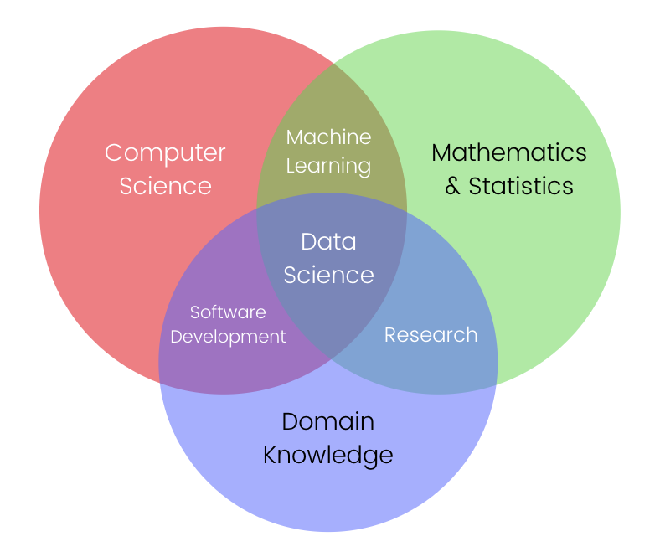
What Defines Data science?
science is an interdisciplinary field that employs scientific methods, processes, and algorithms, to extract valuable insights and knowledge from structData ured and unstructured data.
It encompasses a range of techniques, including statistical analysis, machine learning, and data visualization, to inform decision-making and drive innovation across various industries

Slide 5
Why Data Science Become So Popular Over Time?
Data Explosion - Unprecedented growth in digital data generation fueled the need for proficient analysis, making data science essential.
Technological Advancements - Rapid progress in technologies such as big data analytics and machine learning provided powerful tools for extracting insights from complex datasets.
Business Transformation - Organizations increasingly adopted data-driven decision-making strategies to gain a competitive edge and enhance overall operational efficiency.
Versatility Across Industries - Data science's applicability in diverse sectors, including healthcare, finance, marketing, and more, contributed to its widespread adoption and popularity.

Slide 6
Background
&
Motivation

Slide 7
Project Background :
Despite the booming growth of data-related industries, a noticeable gap exists in the job market for data science professionals.
The demand for data science professionals has surged significantly, reflecting the pivotal role of data in today's industries.
According to Analytics India Magazine, the data science role grew by 45% in 2021, with 93,500+ job openings all over the country. While the demand for data scientists in India is growing, there are also some challenges that come with pursuing a career in this field. One of the biggest challenges is the shortage of skilled professionals.

Slide 8
Motivation and Community Contribution:
Bridging the Skills Gap:
Addressing the growing demand for data science professionals, our project provides insights into the skills and qualifications employers seek, assisting job seekers in making informed career decisions.
Enhancing Efficiency in Job Search:
Simplifying job hunting, our project saves time and effort for job seekers by offering detailed insights into job requirements, empowering them to focus on opportunities aligned with their skills and aspirations.
Tailored Applications for Success:
Empowering job seekers to create tailored resumes and applications aligned with data science job postings significantly increases their chances of success in a competitive job market.
Empowering Education:
Extending contributions to the educational community, our project enables institutions to design more relevant curriculum and training programs, better preparing students for the data science industry and enhancing their employability upon graduation.
.

Slide 9
Project Pipeline

Slide 10







Pipeline :
1
2
3
4
5
6
Gather all the web links related to data science job descriptions available on naukri.com
Retrieve all the job details or requirements related to data science from the gathered links in the previous step
Extract distinct attributes from text that combine multiple features
Perform text analysis, including: lowercasing, tokenize, remove punctuations,...
Feature Engineering including: extract experience level from years, calculate avg skill years, calculate sum of applicants for each skill
Data Analysis and Visualization

Slide 11
Data Collection Process

Slide 12
Data Collection Process :
Data collection for this project was done by web scraping - Naukri.com , an Indian job portal
The data scraping process took place on October 25 and 26, 2023
Web scraping was done using Python packages Selenium and BeautifulSoup
We extracted columns like Job Title, Company Name, Job Location, Job Experience, Job Salary , Job Status, Job Description, Industry Type, Required Education, Key Skills
.

Slide 13
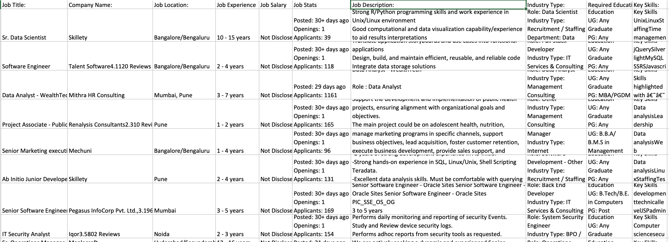
Snapshot of the raw data :

Slide 14

Data Collection Process Demo - Phase 1

Slide 15

Data Collection Process Demo - Phase 2

Slide 16
Feature Engineering

Slide 17
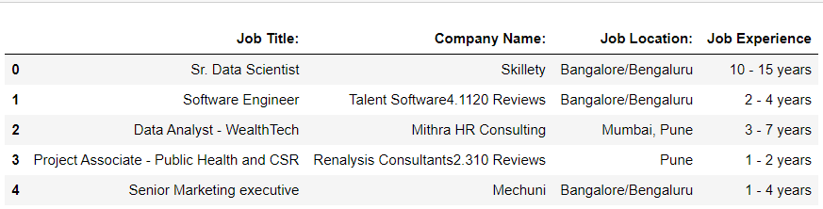
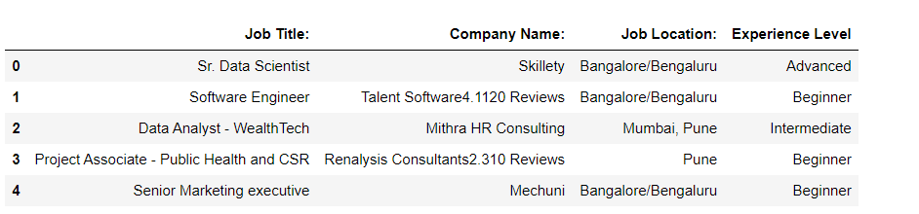
Feature Engineering : Job Experience
Before
After
After

Slide 18
Initial Data Insights :
General Trends and Patterns

Slide 19
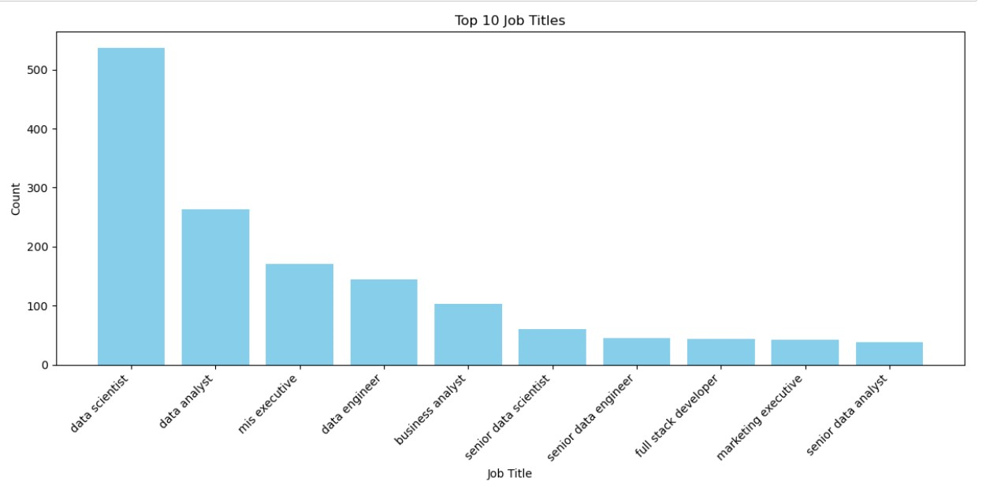
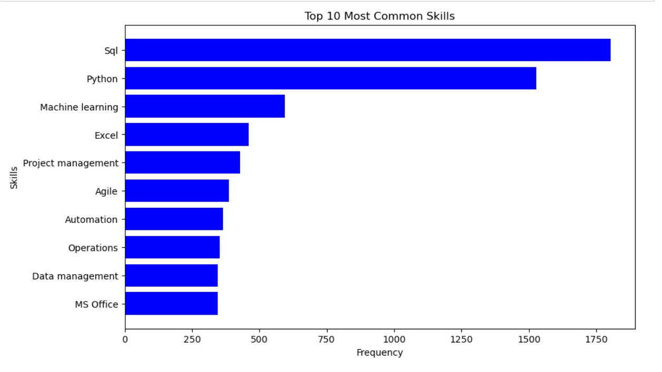
General Analysis and Patterns
Job title analysis - Top 10 job titles Job Skill analysis - Top 10 most common skills

Slide 20
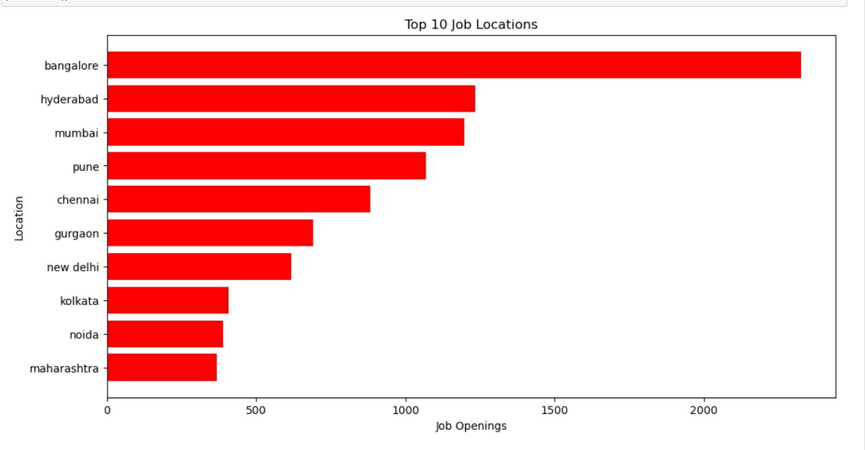
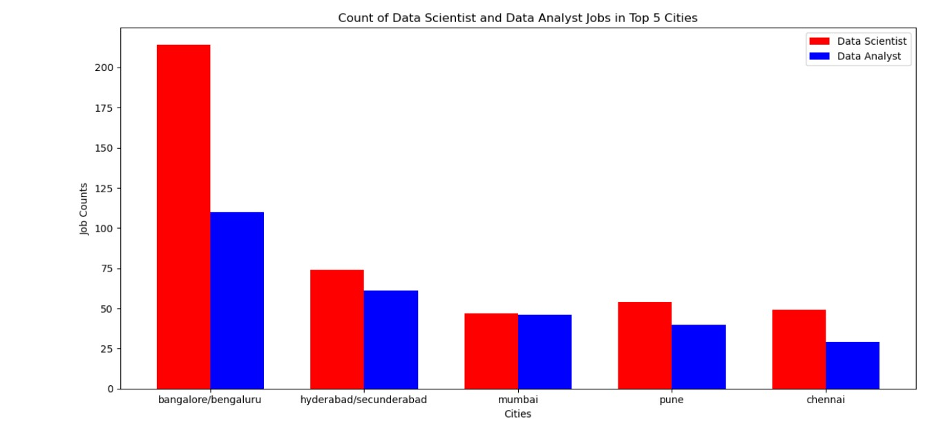
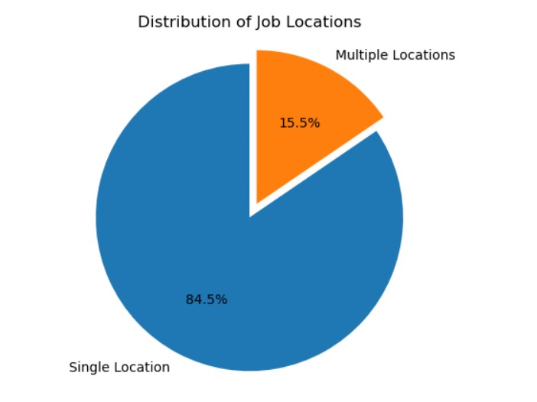
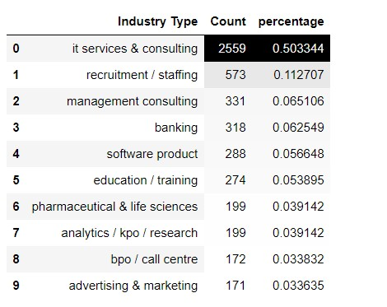
Job locations analysis - Top 10 job locations Count of Data Scientist /Data Analyst jobs in top 5 cities
Distribution of job locations - Single / Multiple cities Most Common industries hiring data science professionals

Slide 21
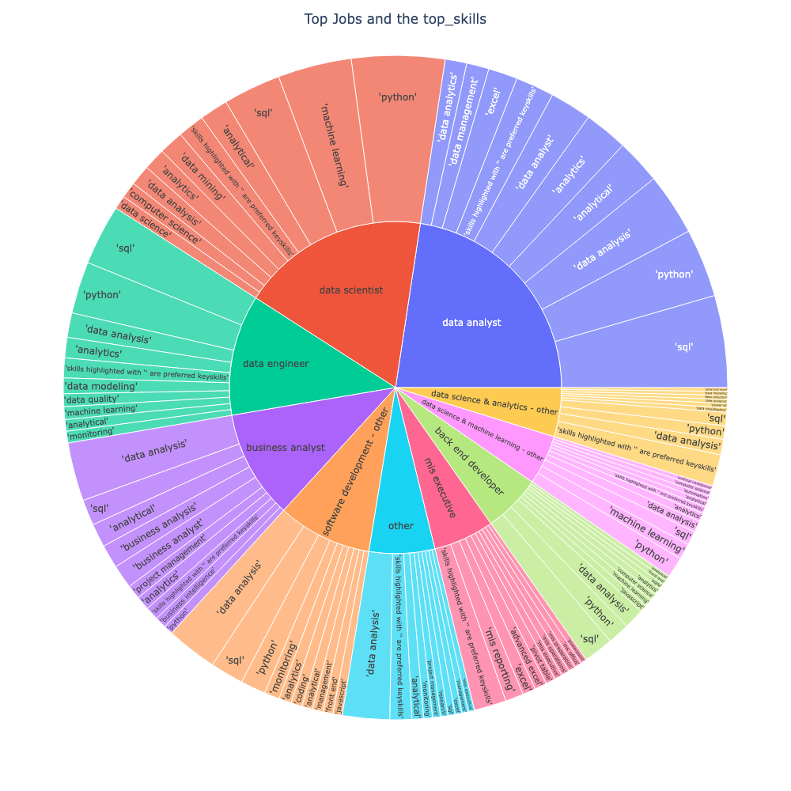
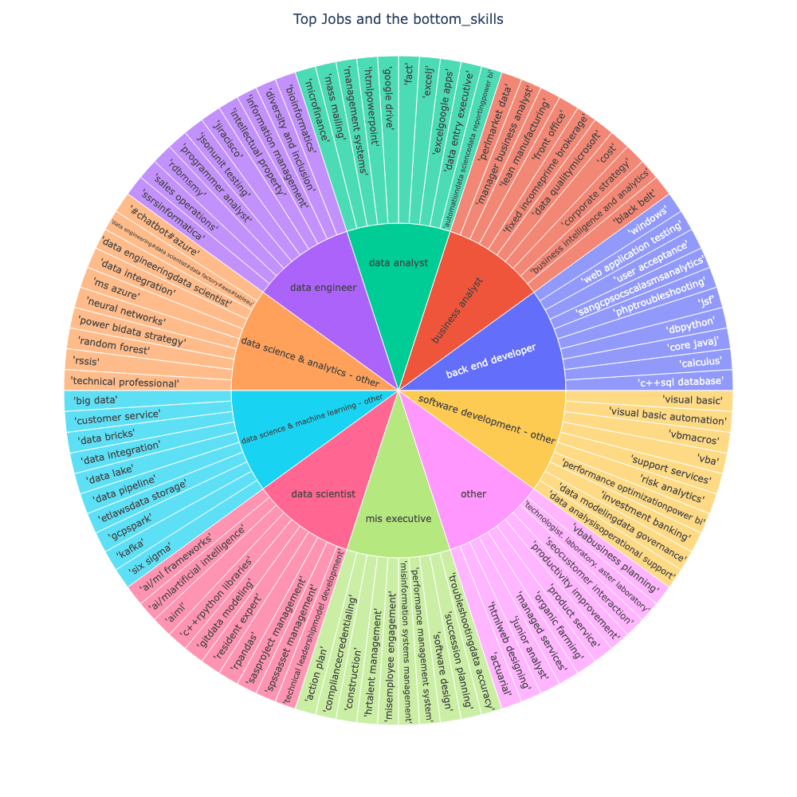
Top 10 skills for top Data Science Skills Bottom 10 skills for top Data Science

Slide 22
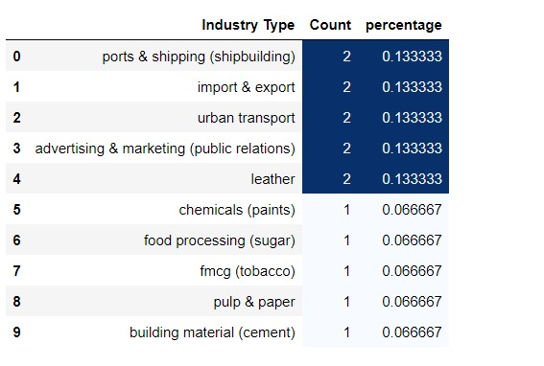
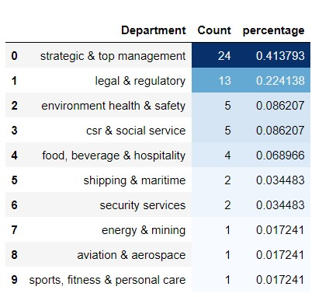
Underlying structures and deviations from the trends
Rare industry types where data science professionals are hired Uncommon Departments where data science is used

Slide 23
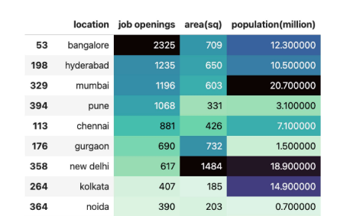
Underlying structures and deviations from the trends
Job openings in different locations vs area and population

Slide 24
Advanced Data Analysis:
In-Depth Exploration

Slide 25
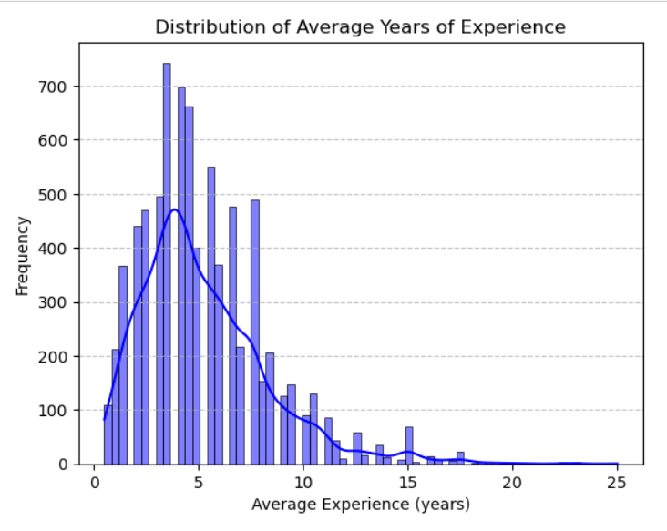
Job Experience Analysis : What is the Average Years of Experience Required in Data Science Domain?
We identified the average years of work experience required in the data science domain.
The most common years of experience was 3-4 years

Slide 26
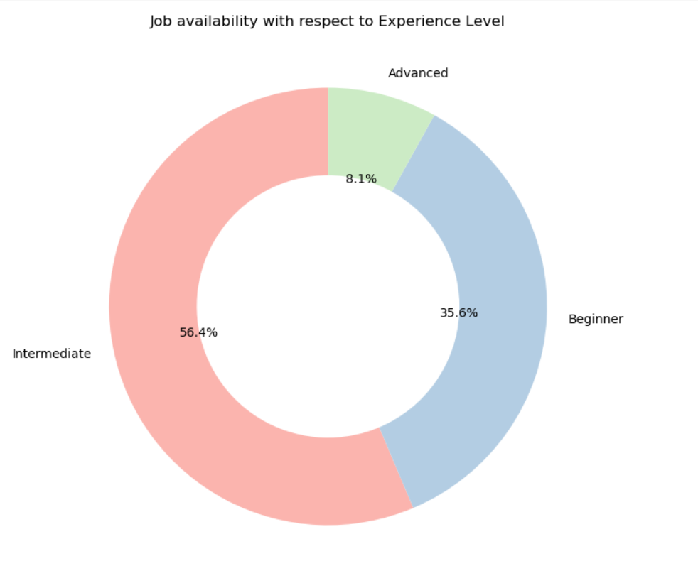
How Job Openings Are Distributed Across Various Experience Levels?
We have split the job availability in the market
based on the experience level .
We ranked
0-3 : Beginners
4-9 : Intermediate
10 and up : Advanced
It was seen that most of the jobs have openings
for intermediate level

Slide 27
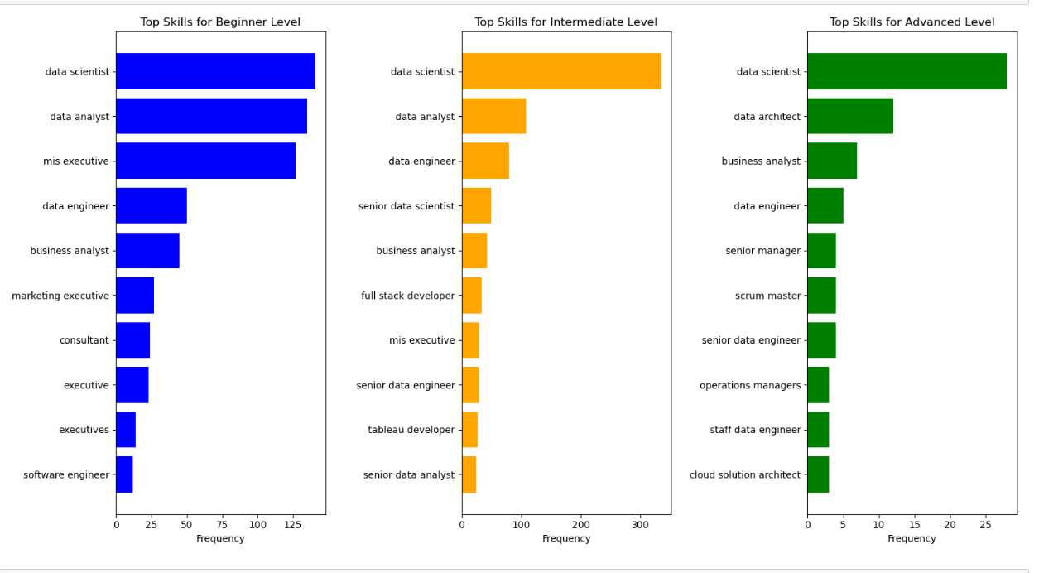
What Are the Common Job Roles Across Different Experience Levels?

Slide 28
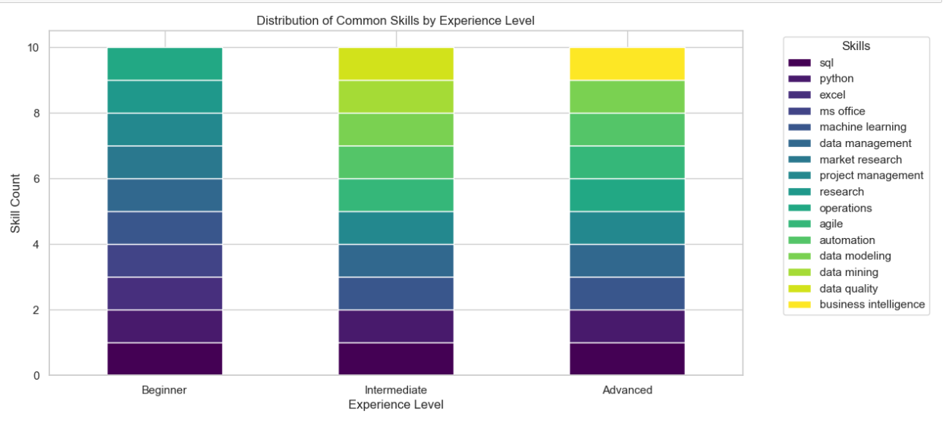
What Are Common Skills in Different Experience Levels?

Slide 29
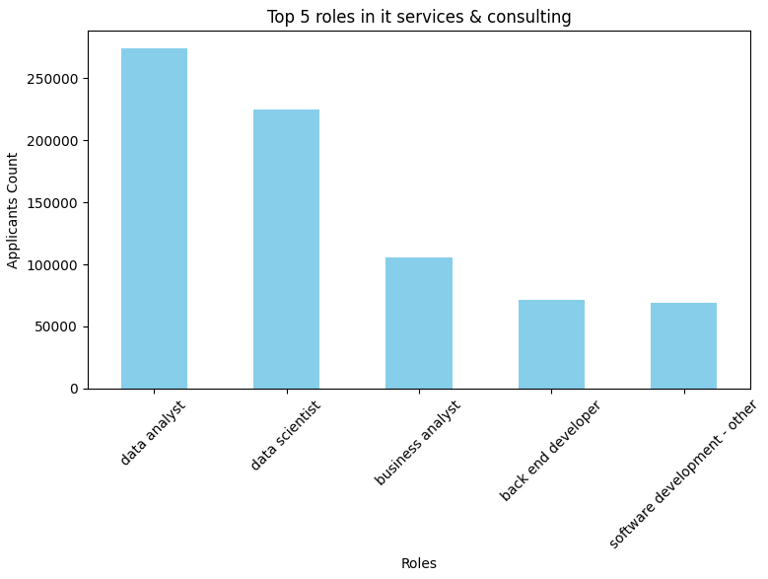
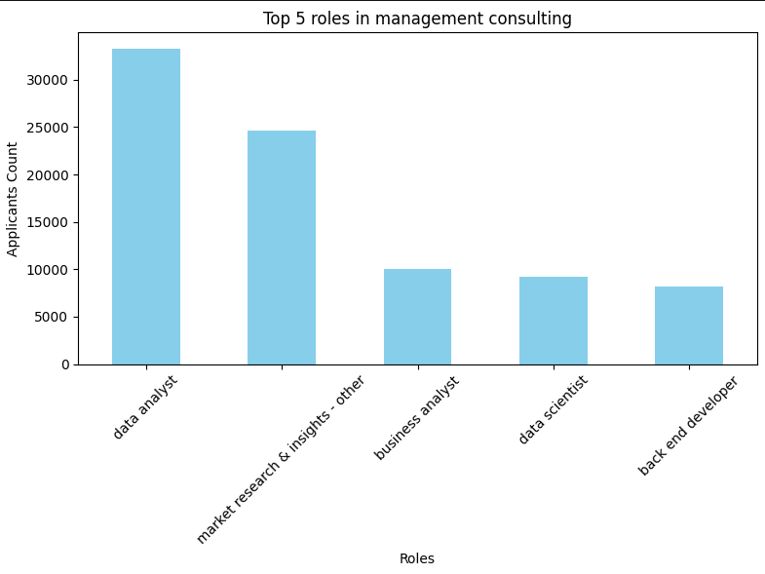
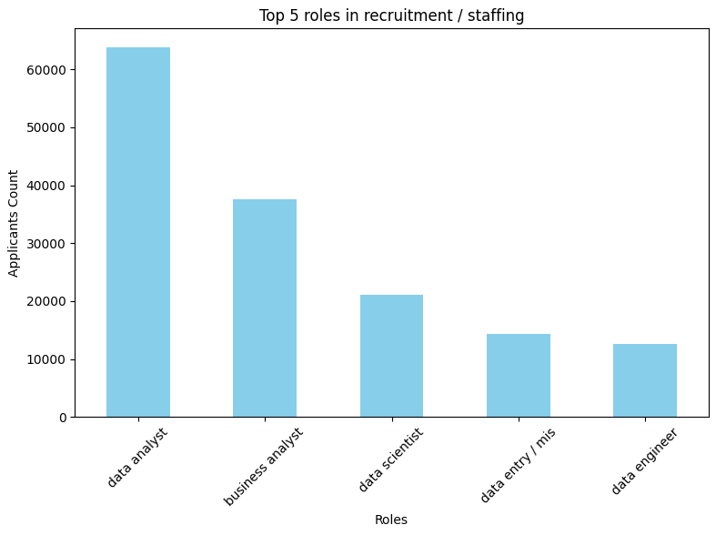
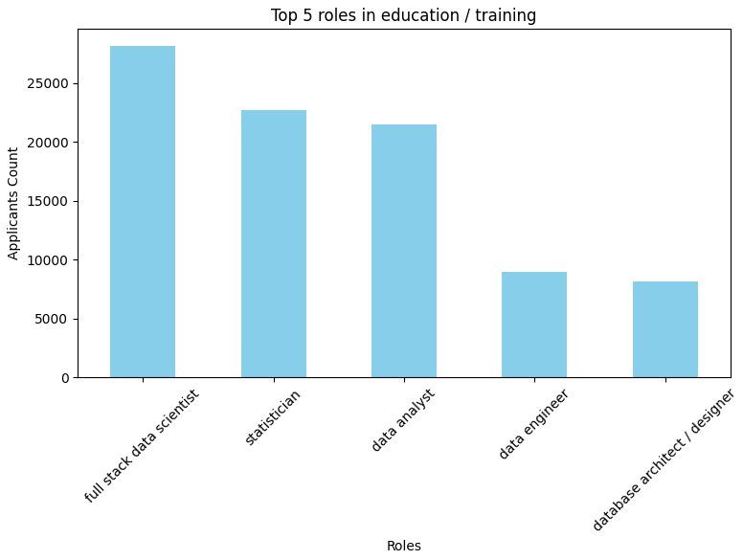
Industry Level Analysis : What are Most Popular Job Roles Preferred by Applicants in different Industries?
1
3
2
4

Slide 30
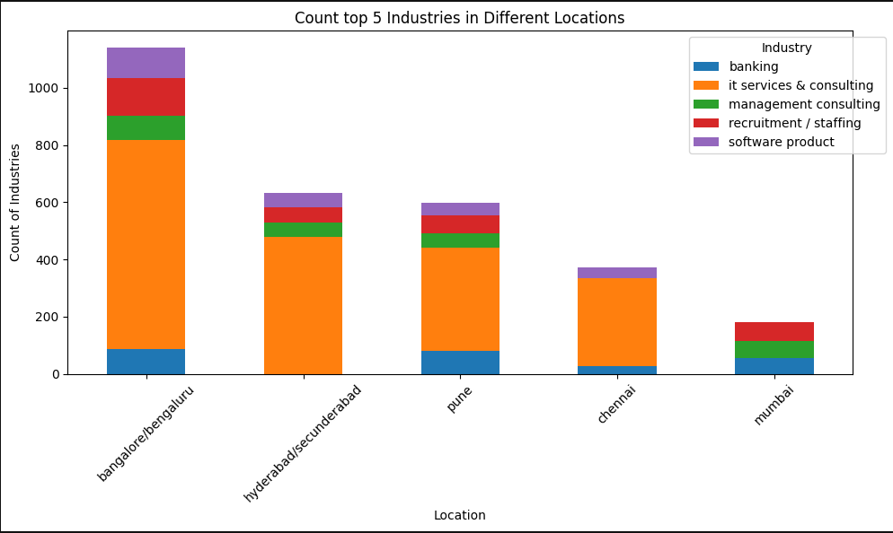
How Top 5 Industries Distributed Across Different Locations?

Slide 31
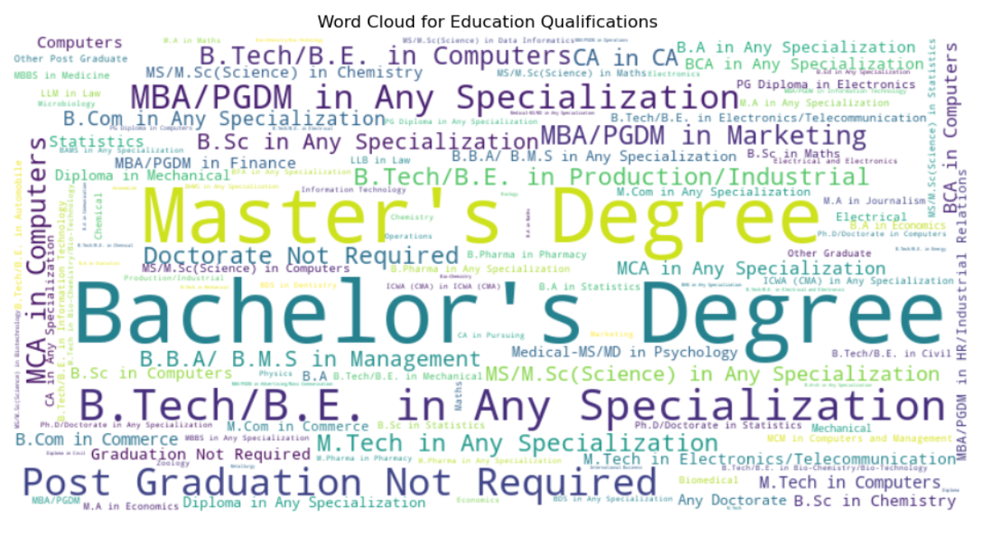
Educational and Skill Analysis : What Education Qualifications are Preferred in Most Data Science Jobs?

Slide 32
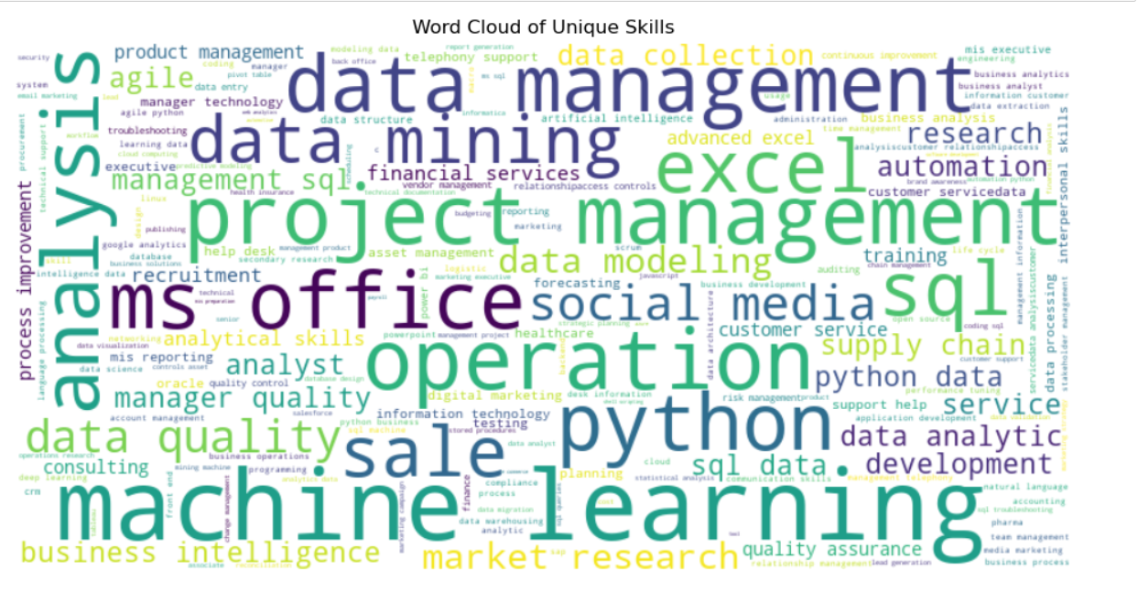
What Are Most Important Skills Required by Current Job Market?

Slide 33
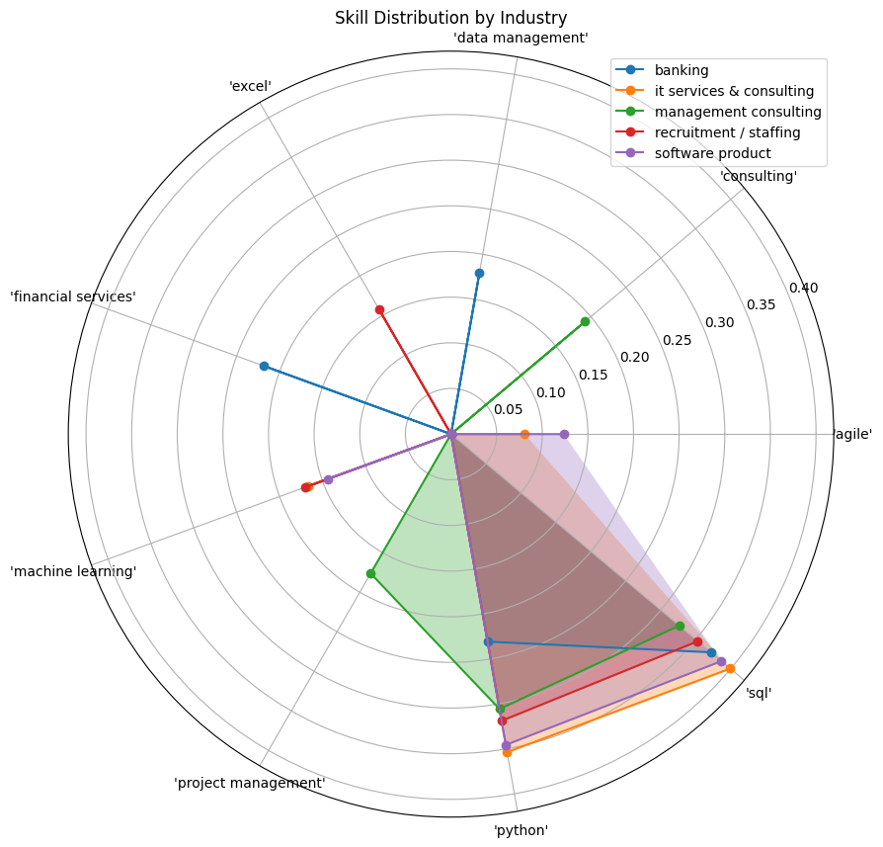
What Skills Top Industries Looking for?

Slide 34
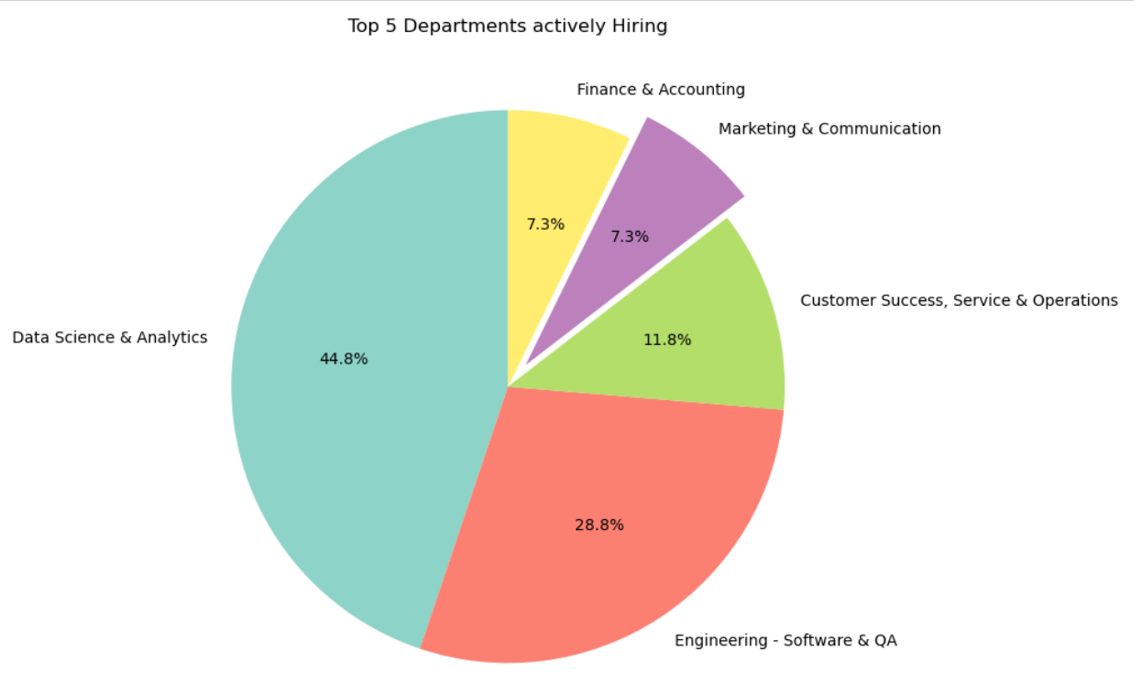
Department Level Analysis : Which departments are actively hiring data science professionals?

Slide 35
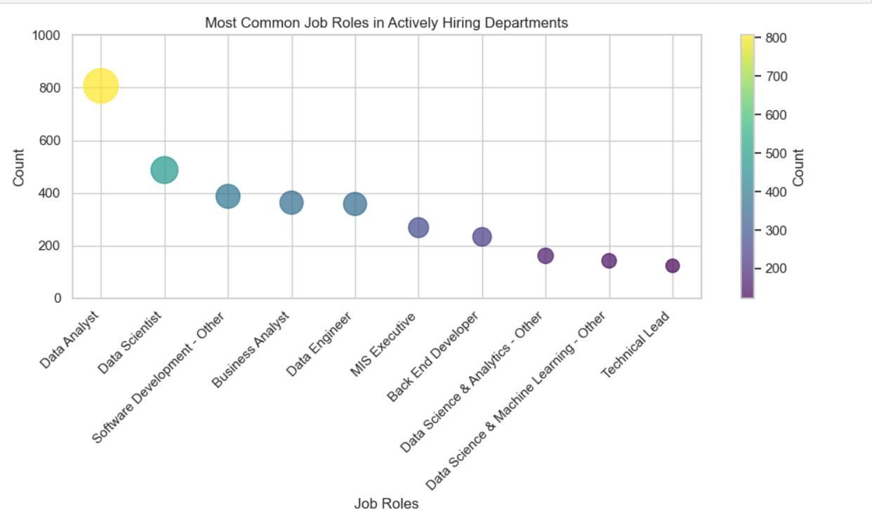
What are the Common Job Roles in Top Hiring Departments ?

Slide 36
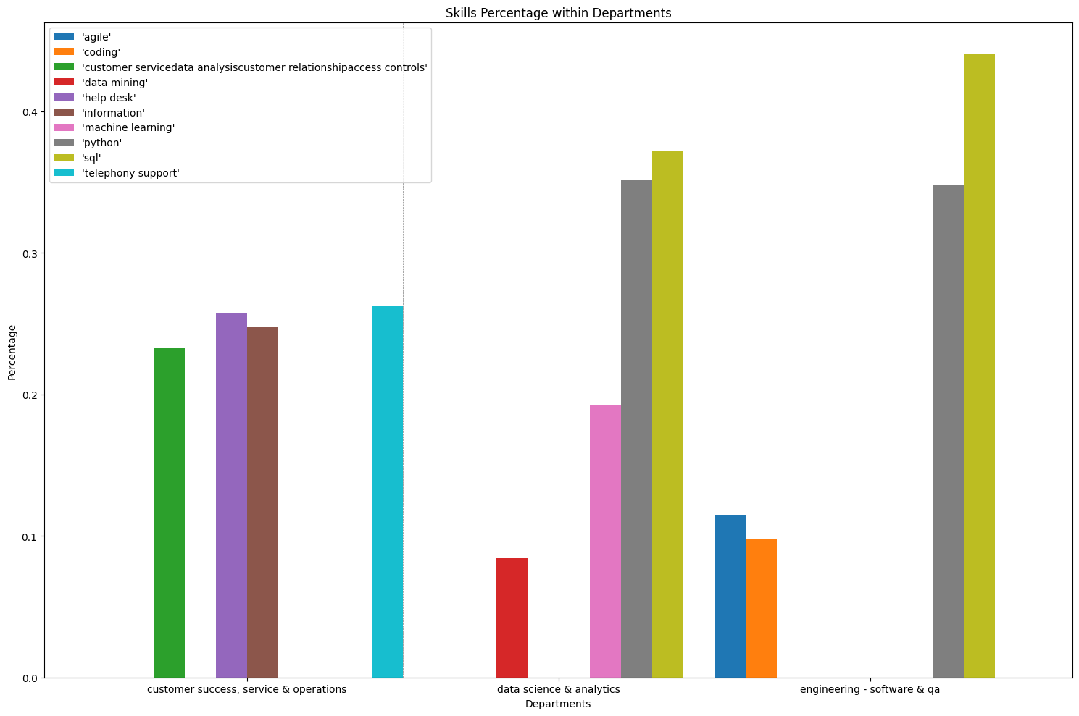
What Are Most Common Skills Within Different Departments?

Slide 37
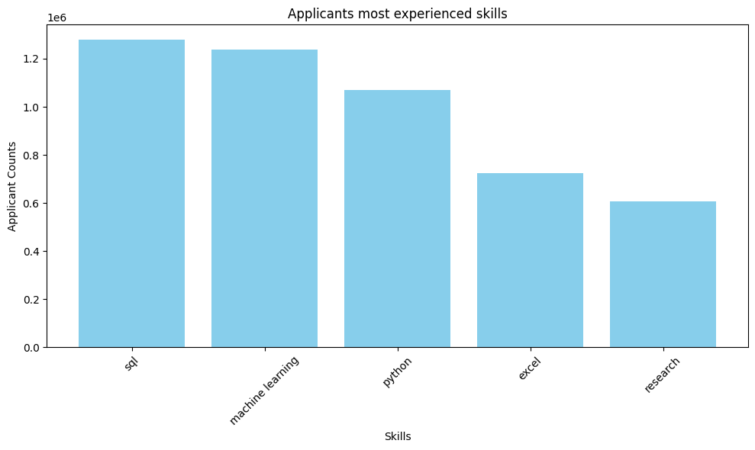
What expertise do the majority of applicants possess?

Slide 38
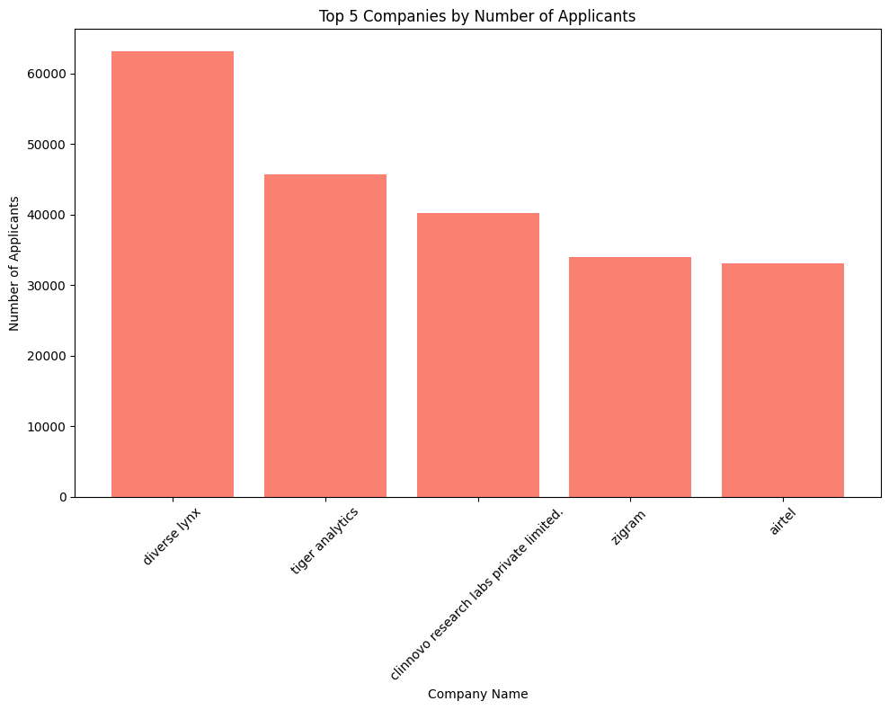
Which Companies Are Preferred by Applicants the Most?

Slide 39
What Are the Trends in Required Skills Over Time?(May 2022, Nov 2022, Nov2023)
Common top skills: {'sql', 'python', 'data management', 'machine learning'}
Skills Added in Nov 2022: {'nlp', 'tableau', 'r', 'data analytics'}
Skills Added in Nov 2023: {'agile', 'project management', 'automation', 'operations', 'ms office', 'excel'}

Slide 40
What is Unique about our Project?

Slide 41
What is the uniqueness in this Project ?
Industry-Specific Skill-sets:
Our project provides a thorough analysis of skill-sets tailored to specific industries. For instance an individual aspiring to enter a particular industry can gain insights into the precise set of skills they should focus on for effective interview preparation.
Departmental Focus: Our project explores which departments within organizations are most actively hiring data science professionals. This helps in understanding the collaboration between data science teams and other departments, such as marketing, finance, or research and development. Also, it will help job hunters to know which departments is the best to network with current employees to obtain more information about roles.

Slide 42
Conclusion

Slide 43
Conclusion
Our analysis in this project involved the utilization of data collected through web scraping to gain insights into the current landscape of data science jobs.
Through data analysis, we successfully identified:
The key skills essential for the field
The required experience levels
Industry-specific skills
Department-oriented skills
Top companies preferred by the applicants
Trends in required skills over time

Slide 44
Thank You!

